Slide 1
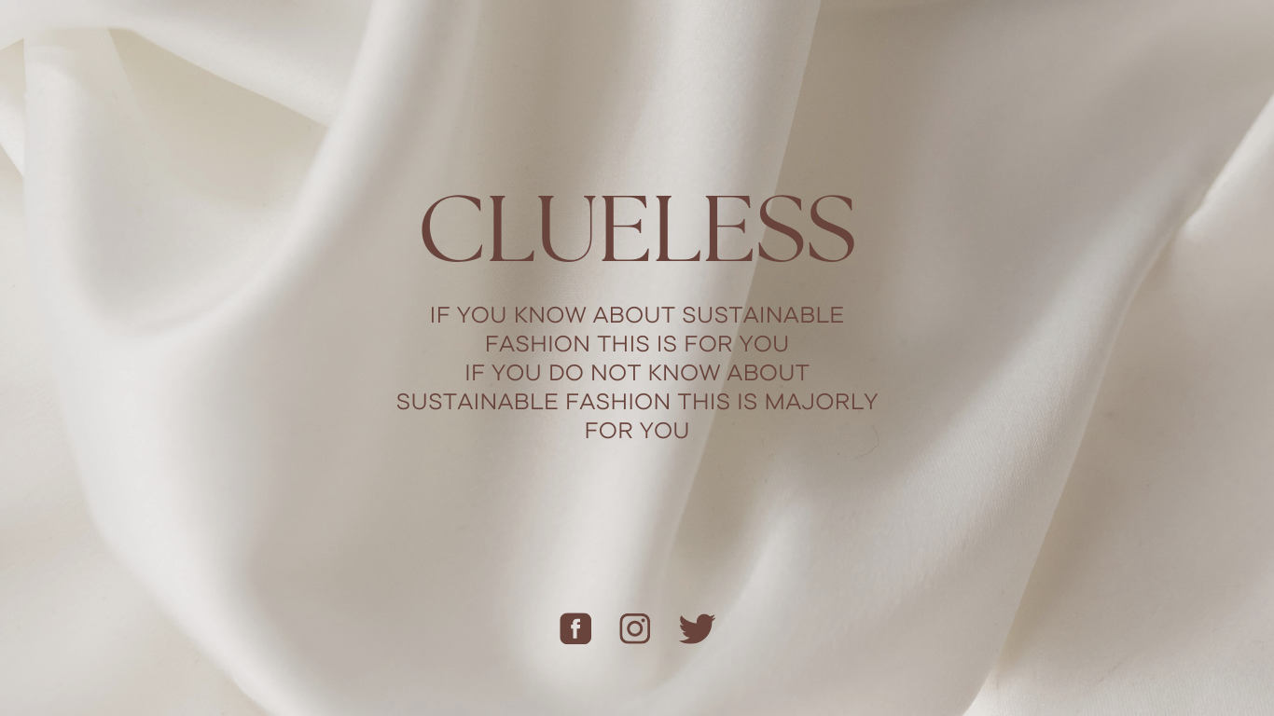
By-CC31

Slide 2

Fast Fashion and Its Environmental Impact
THE DARK SIDE OF FASHION INDUSTRY
According to an analysis by Business Insider, fashion production comprises 10% of total global carbon emissions, as much as the European Union.

Slide 3
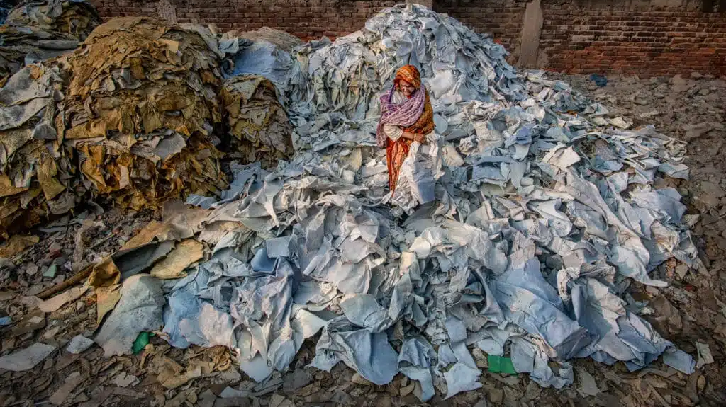
Water
The environmental impact of fast fashion comprises the depletion of non-renewable sources, emission of greenhouse gases and the use of massive amounts of water and energy
Microplastics
Furthermore, brands use synthetic fibres like polyester, nylon and acrylic which take hundreds of years to biodegrade. A 2017 report from the International Union for Conservation of Nature (IUCN) estimated that 35% of all microplastics – tiny pieces of non-biodegradable plastic – in the ocean come from the laundering of synthetic textiles like polyester.
Energy
The production of making plastic fibres into textiles is an energy-intensive process that requires large amounts of petroleum and releases volatile particulate matter and acids like hydrogen chloride. Additionally, cotton, which is in a large amount of fast fashion products, is also not environmentally friendly to manufacture. Pesticides deemed necessary for the growth of cotton presents health risks to farmers.

Slide 4
The Social Impacts of Fast Fashion
According to non-profit Remake, 80% of apparel is made by young women between the ages of 18 and 24.
A 2018 US Department of Labor report found evidence of forced and child labour in the fashion industry in Argentina, Bangladesh, Brazil, China, India, Indonesia, Philippines, Turkey, Vietnam and others.
In 2013, an eight-floor factory building that housed several garment factories collapsed in Dhaka, Bangladesh, killing 1 134 workers and injuring more than 2,500.

Slide 5
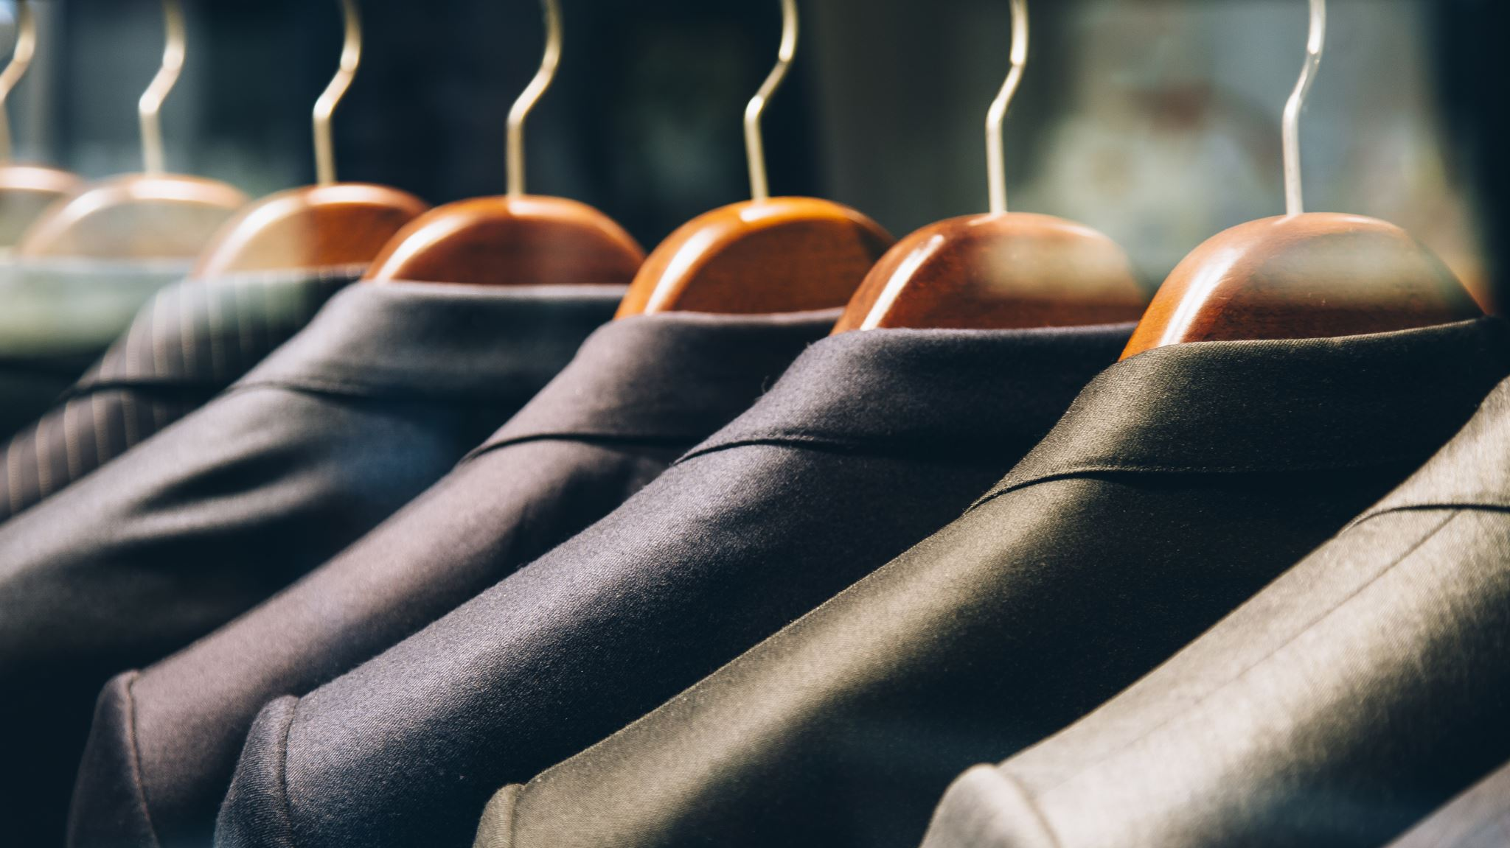
Mission of CLUELESS
CLUELESS aims to revolutionize the fashion industry by promoting sustainability and transparency. Our platform connects environmentally-conscious consumers with eco-friendly fashion brands, helping everyone make responsible wardrobe choices.

Slide 6

CORE FEAUTURES OF CLUELESS
BRAND DIRECTORY VIRTUAL CLOSET CONNECTION HUB RECOMMENDATIONS
EDUCATION RESOURCES

Slide 7
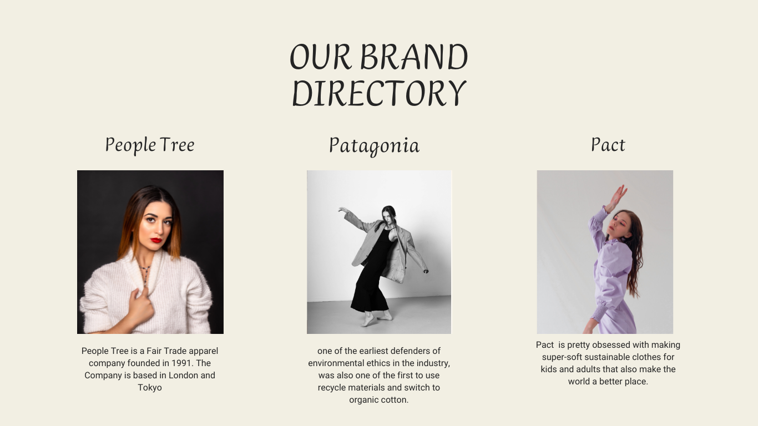
OUR BRAND DIRECTORY
Showcase the user-friendly interface of the Sustainable Brand Directory.
Display logos or images of featured brands that align with eco-friendly practices.

Slide 8
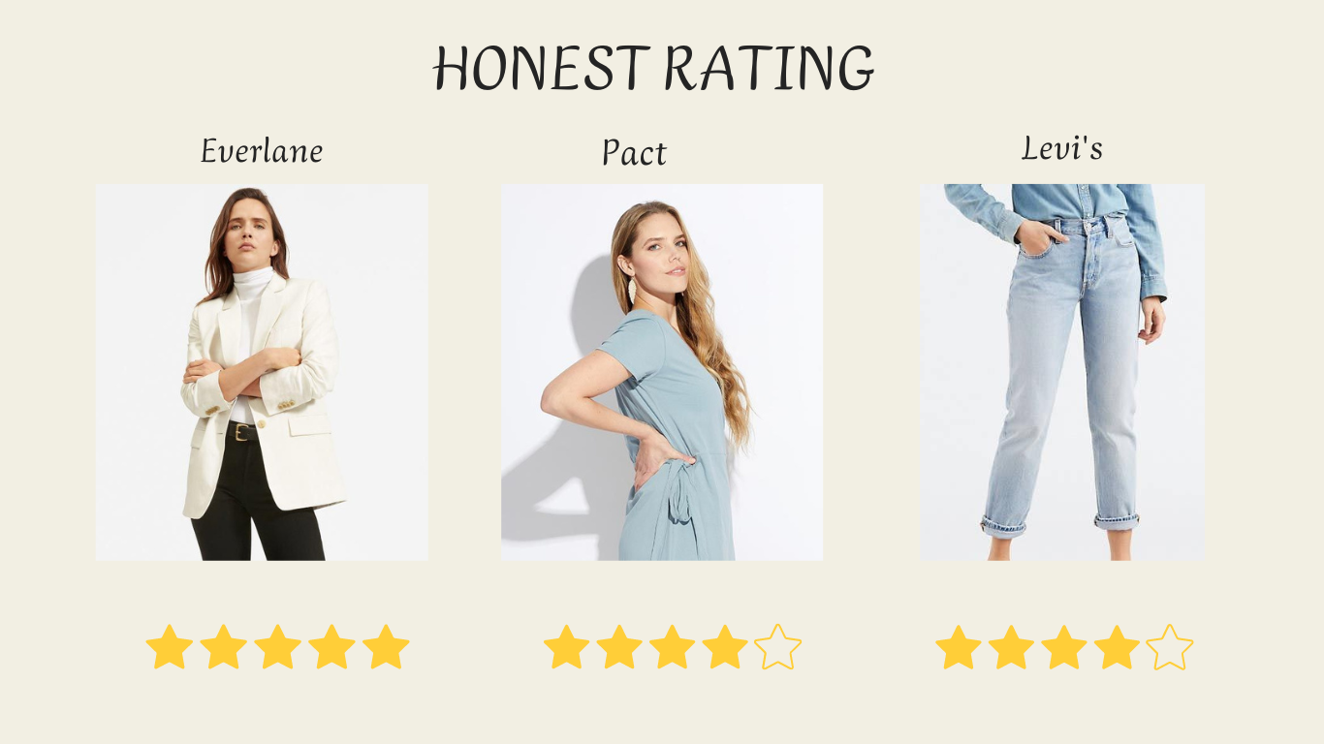
OUR BRAND DIRECTORY GIVING HONEST REVIEW
CLUELESS employs a rating system that assesses each product's environmental impact. Consumers can easily compare different clothing items based on their sustainability scores

Slide 9
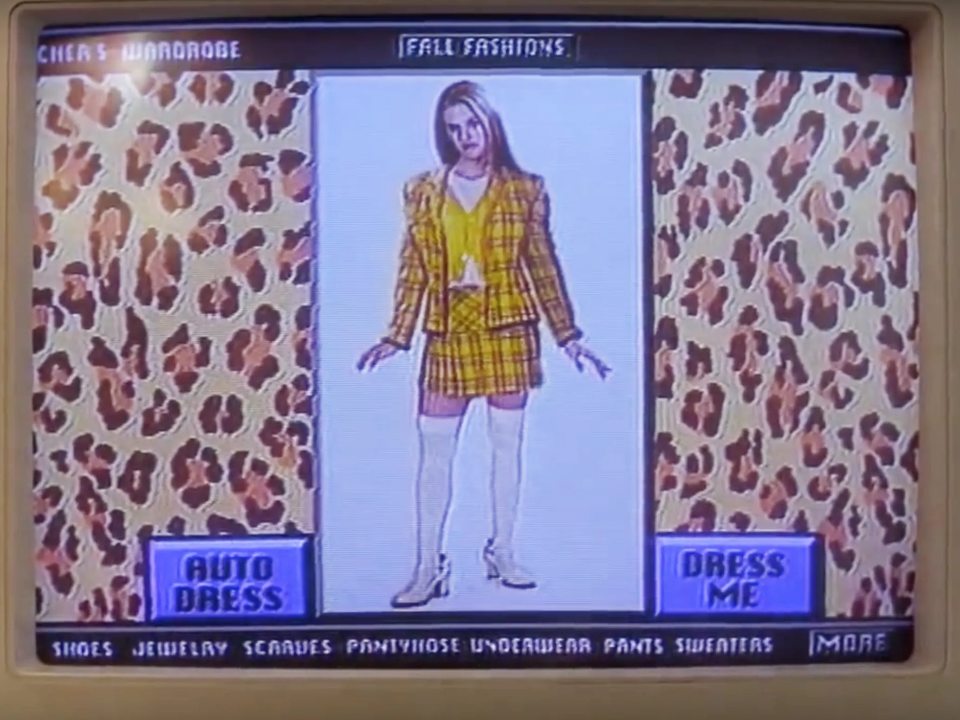
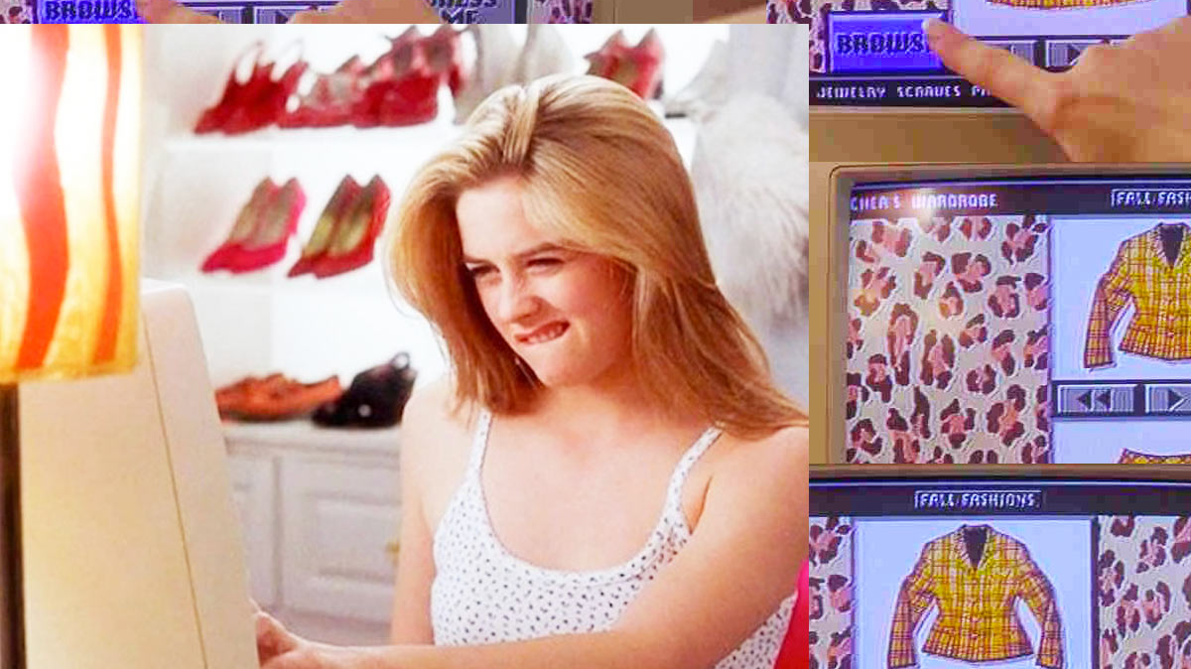
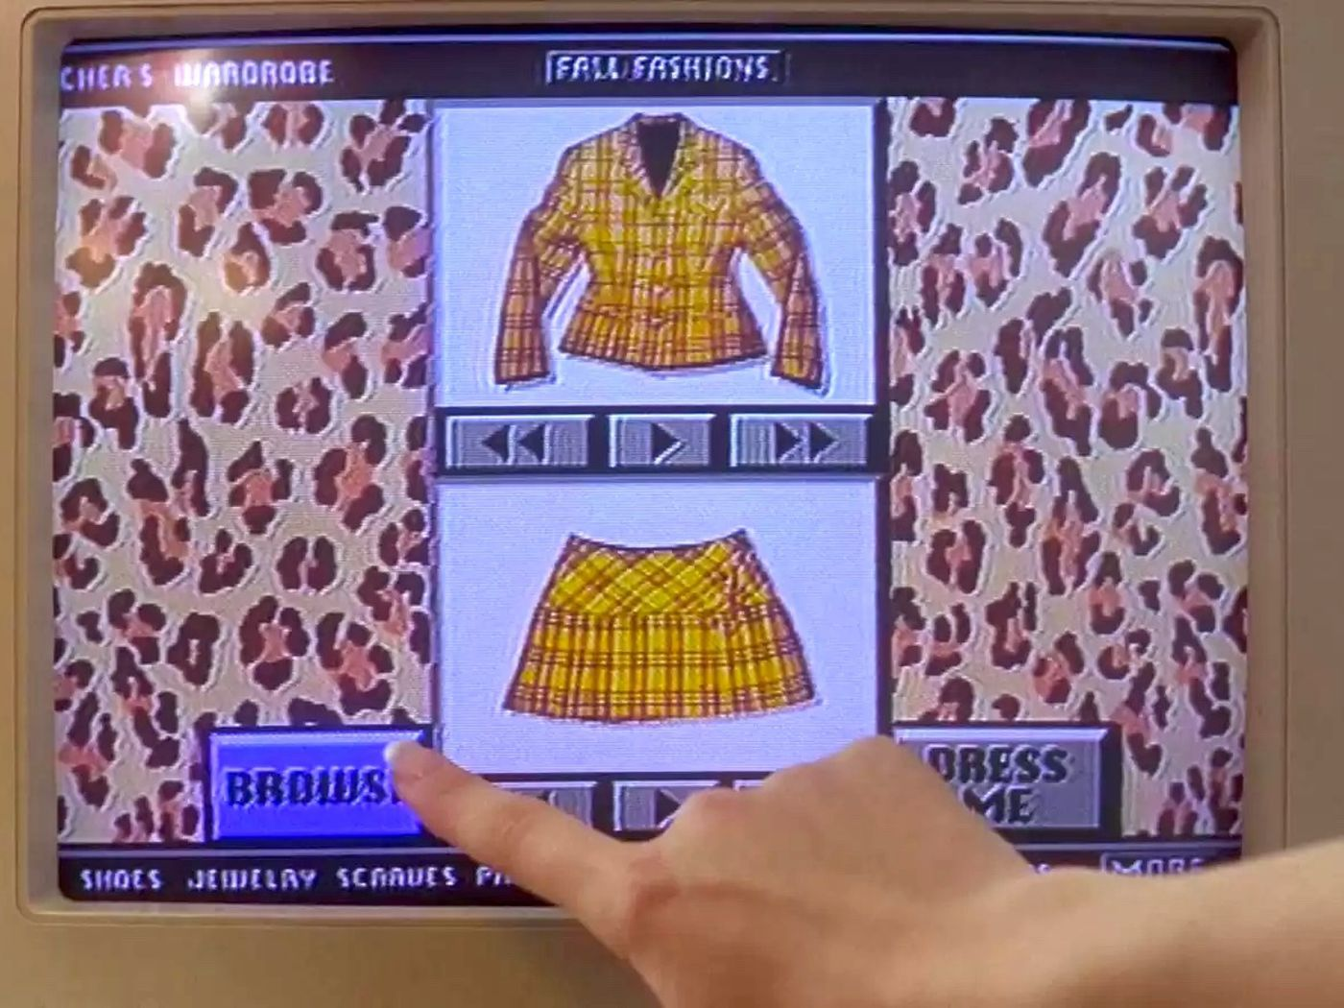
THE VIRTUAL CLOSET-A new visual recognition system will give you sartorial tips—a chance to channel your inner Cher Horowitz. Users can upload their clothing items and receive eco-friendly suggestions.

Slide 10

A video representation of how it will work.

Slide 11

The connection Hub and Community Forum

Slide 12

Recommendations-Utilizing AI algorithms, CLUELESS offers users personalized recommendations based on their style preferences and sustainability preferences.

Slide 13
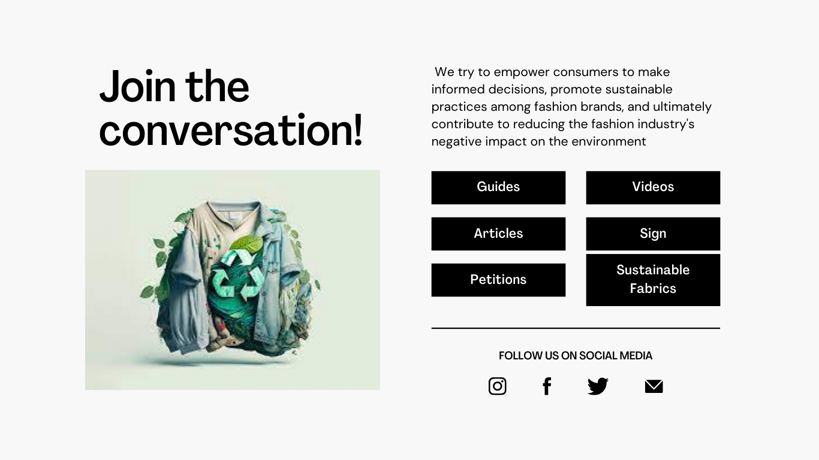
Education Resources-Engaging articles, videos, and interactive guides on sustainable fashion, eco-friendly fabrics, and how to make environmentally conscious choices.

Slide 14
TECH STACK REQUIREMENTS
Front-end:
HTML/CSS/JavaScript: The backbone of the front-end development, responsible for website layout, styling, and interactivity.
React.js: A popular JavaScript library for building interactive user interfaces. React allows for the creation of reusable UI components and smooth, dynamic updates.
Redux: A state management library that helps manage the application's state and data flow efficiently.
Back-end:
Node.js: A server-side JavaScript runtime environment that allows for building scalable and fast web applications.
Express.js: A web application framework for Node.js that simplifies the creation of APIs and handling HTTP requests.
MongoDB: A NoSQL database that provides flexibility for handling unstructured data, such as product information, user profiles, and ratings.
Mongoose: An Object Data Modeling (ODM) library for MongoDB, facilitating the interaction between Node.js and the database.

Slide 15
TECH STACK REQUIREMENTS
AI and Machine Learning:
Python: A widely used language for AI and machine learning tasks.
TensorFlow / PyTorch: Powerful libraries for building and training AI models, which can be used for personalized recommendations and carbon footprint calculations.
Server Hosting:
AWS / Azure / Google Cloud: Cloud service providers for hosting the application, databases, and AI models. These platforms offer scalability and reliability.
APIs and Integrations:
Third-party APIs: Integration with external APIs for services such as sustainable certifications, shipping, and payment gateways.
Version Control:
Git: For version control and collaboration during development.

Slide 16
TECH STACK REQUIREMENTS
Web Design and Prototyping:
Adobe XD / Sketch: For designing and prototyping the user interface before development.
Other Considerations:
Blockchain (optional): If transparency in the supply chain is a significant aspect of the project, integrating a blockchain solution could ensure an immutable and transparent record of the supply chain.
Content Delivery Network (CDN): To ensure fast and efficient delivery of website assets to users across the globe.

Slide 17

THANK YOU!
REFRENCES-
https://earthorg.mystagingwebsite.com/fast-fashions-detrimental-effect-on-the-environment/#:~:text=The%20Dark%20Side%20of%20Fast%20Fashion&text=It%20dries%20up%20water%20sources,of%2050%20billion%20plastic%20bottles.

